Slide 1
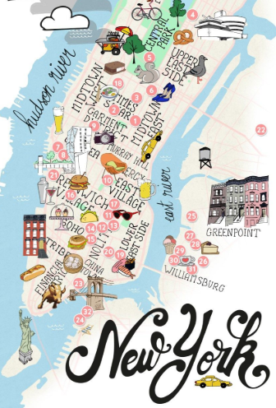
Know-b4-u-go
ERIC LIEU
MJ VILLACRESES
FRANCIS IMPERIAL
AMANDA WISHNIE
Notes:
How many of you have rented an Airbnb?
Who did research on the cities they were visiting prior to making a decision?
I’m assuming you has had to click through multiple different websites to find everything you wanted to know…

Slide 2
How are we going to help you?
WHITESPACE OPPORTUNITY Application that provides all the data you need to plan your next trip
FEATURES Airbnb pricing history Crime Data overview Where to eat & drink Insights Analysis
MOTIVATIONS:
SIMPLIFYING THE DECISION MAKING PROCESS WHEN PLANNING A TRIP
WHERE:
AIRBNB OPEN SOURCE
ZOMATO
VADER PYTHON PACKAGE
HOW:
PYTHON
HTML/CSS
JAVASCRIPT
API’s
MACHINE LEARNING
Notes:
That’s where we come! We are filling a white-space in the market that’s a one stop shop to get a holistic perspective of where you’ll be staying
KNOW B4 U GO!
We currently have 4 main features rolled out on our beta site and for our test are only focusing on New York City
Airbnb pricing history from 2018 by neighborhood
NYPD crime data from 2018
What bars and restaurants there are by neighborhood / rating
Insights Analysis overviewing Airbnb comments from 2018

Slide 3
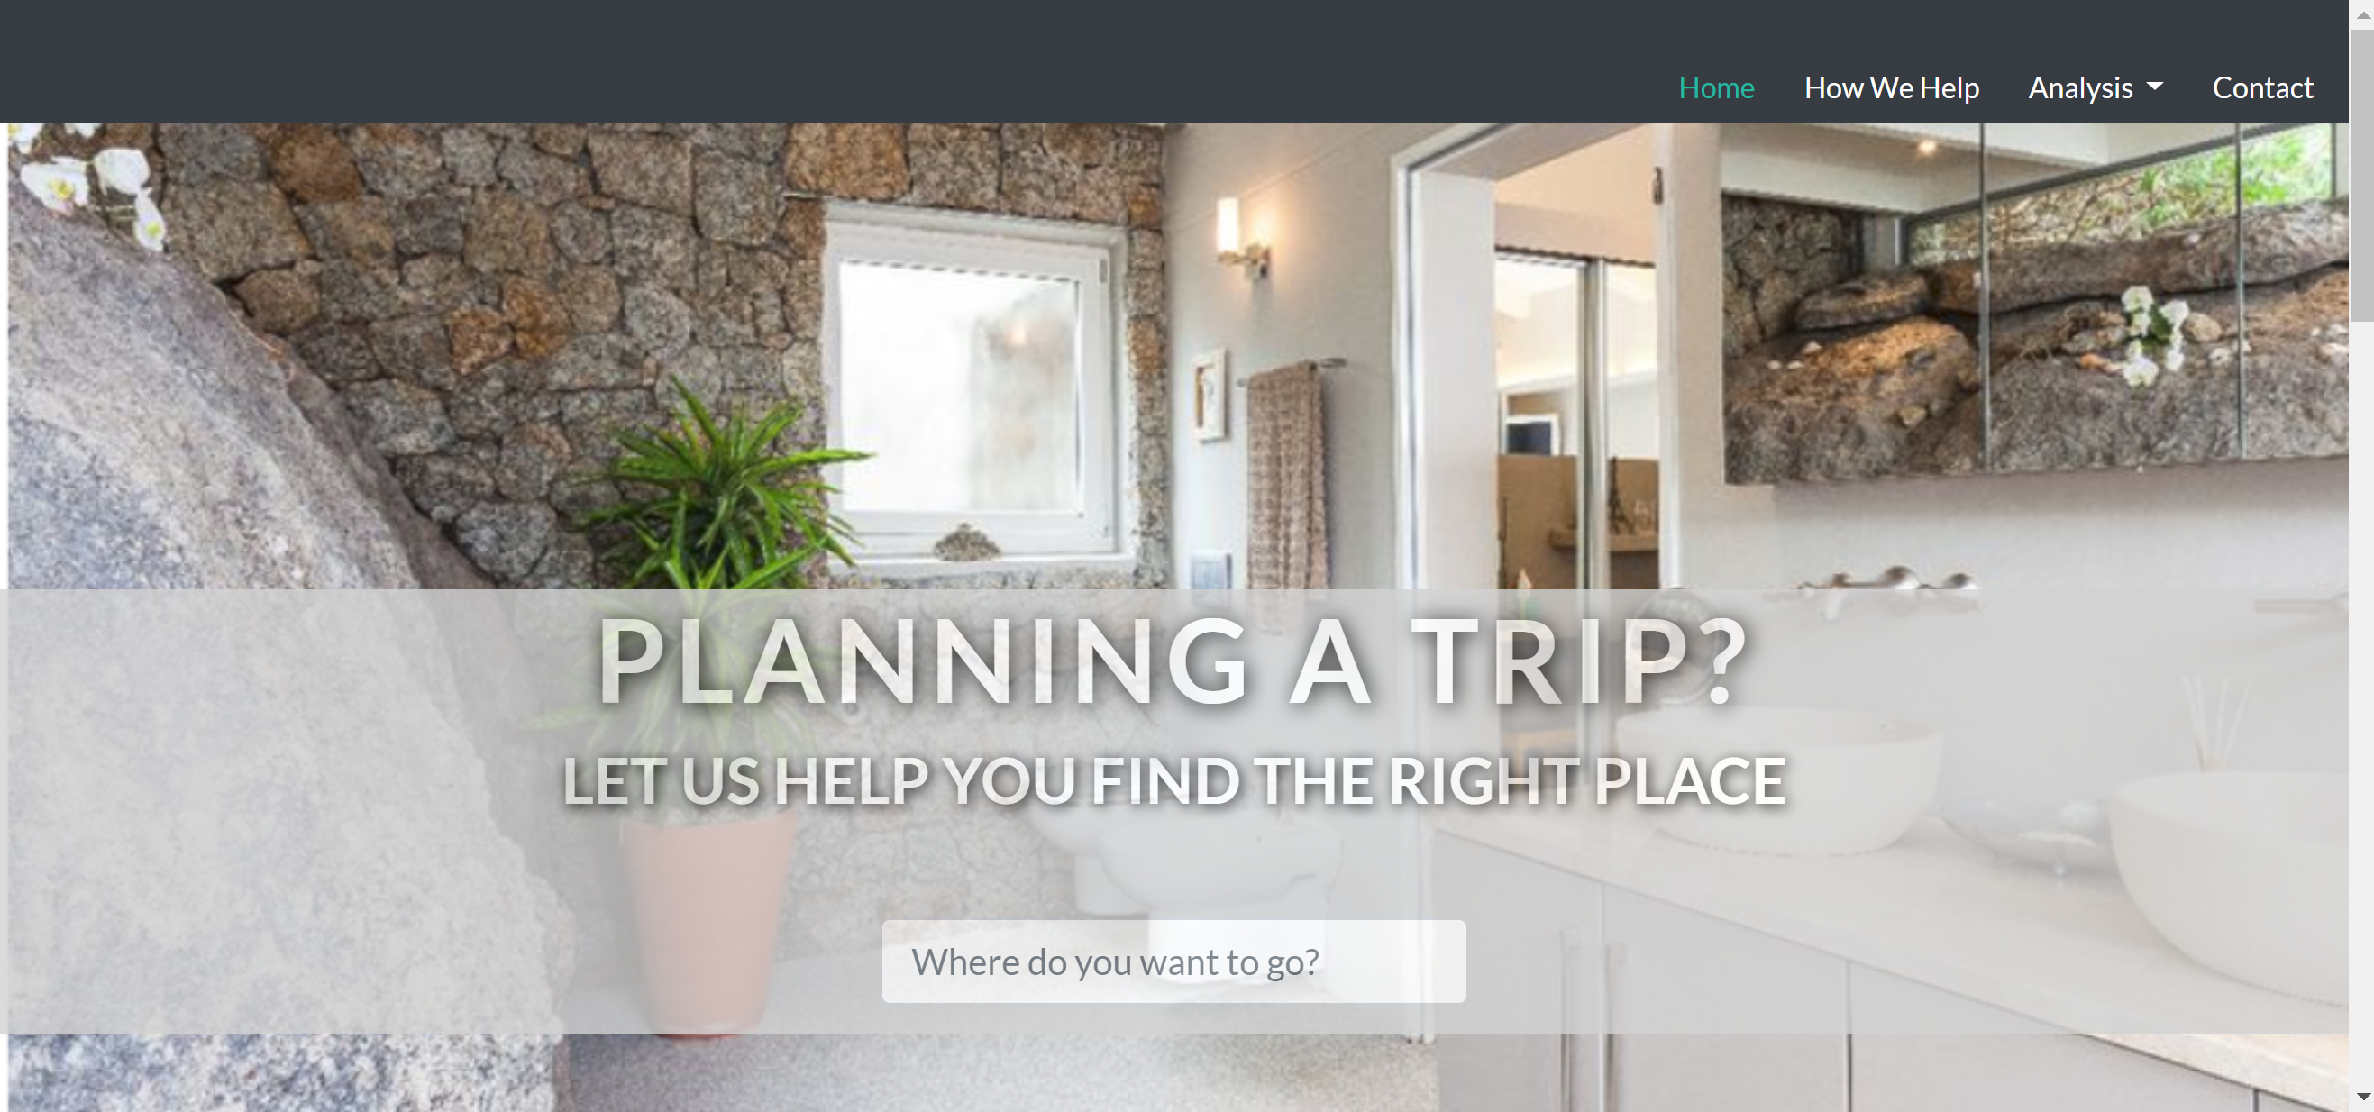
WHAT DID WE DO?
Notes:
We built a website with HTML/CSS to display our findings and provide an interactive UI/UX for our users
This is currently only a web-based application but will eventually launch as an app.
I am now going to pass it over to Francis so he can take you through our amazing features

Slide 4
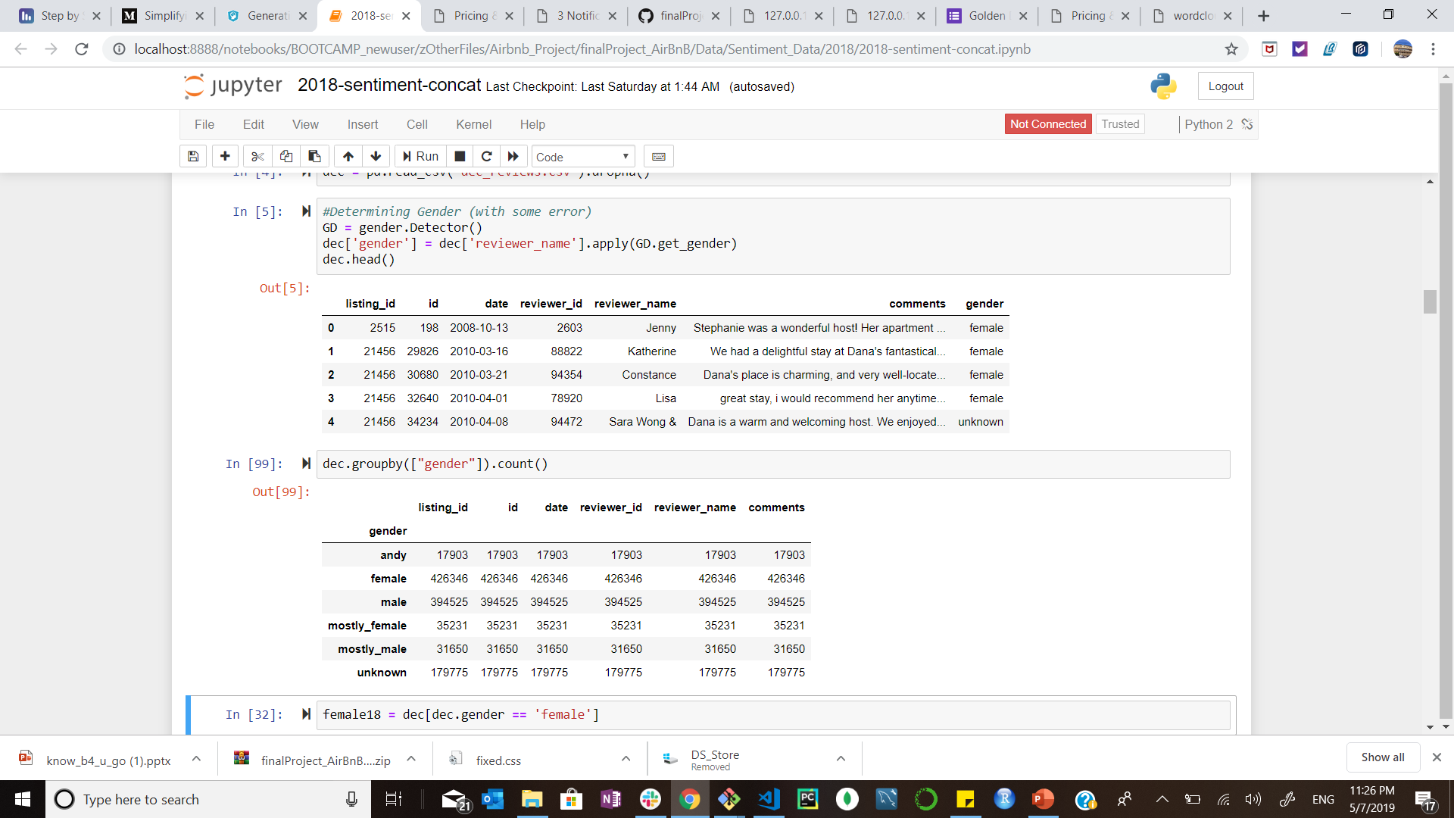
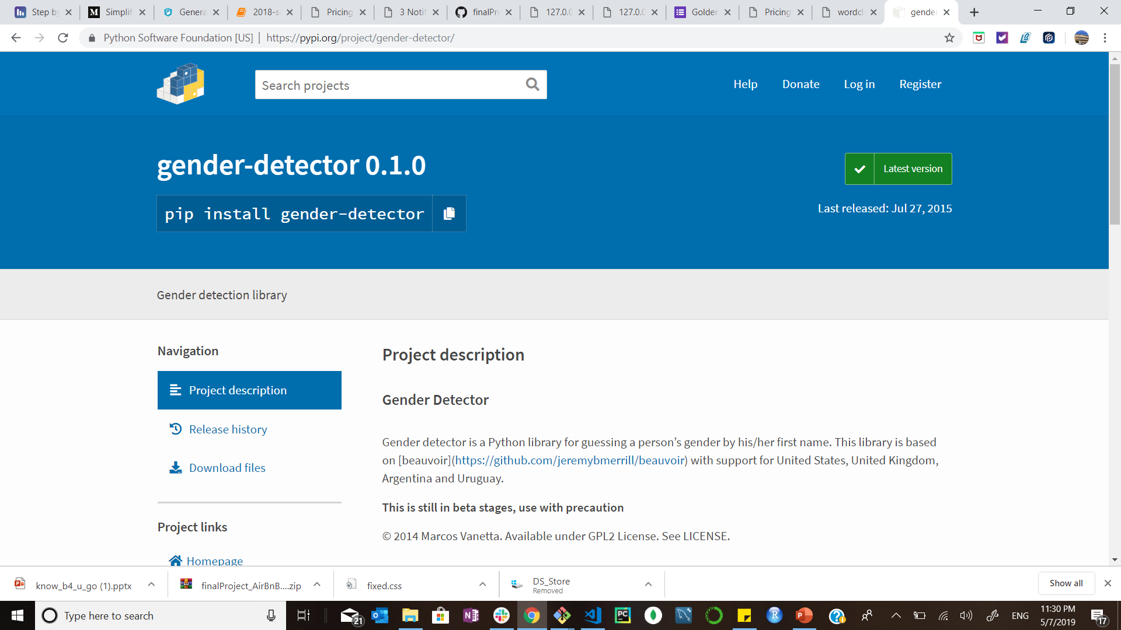
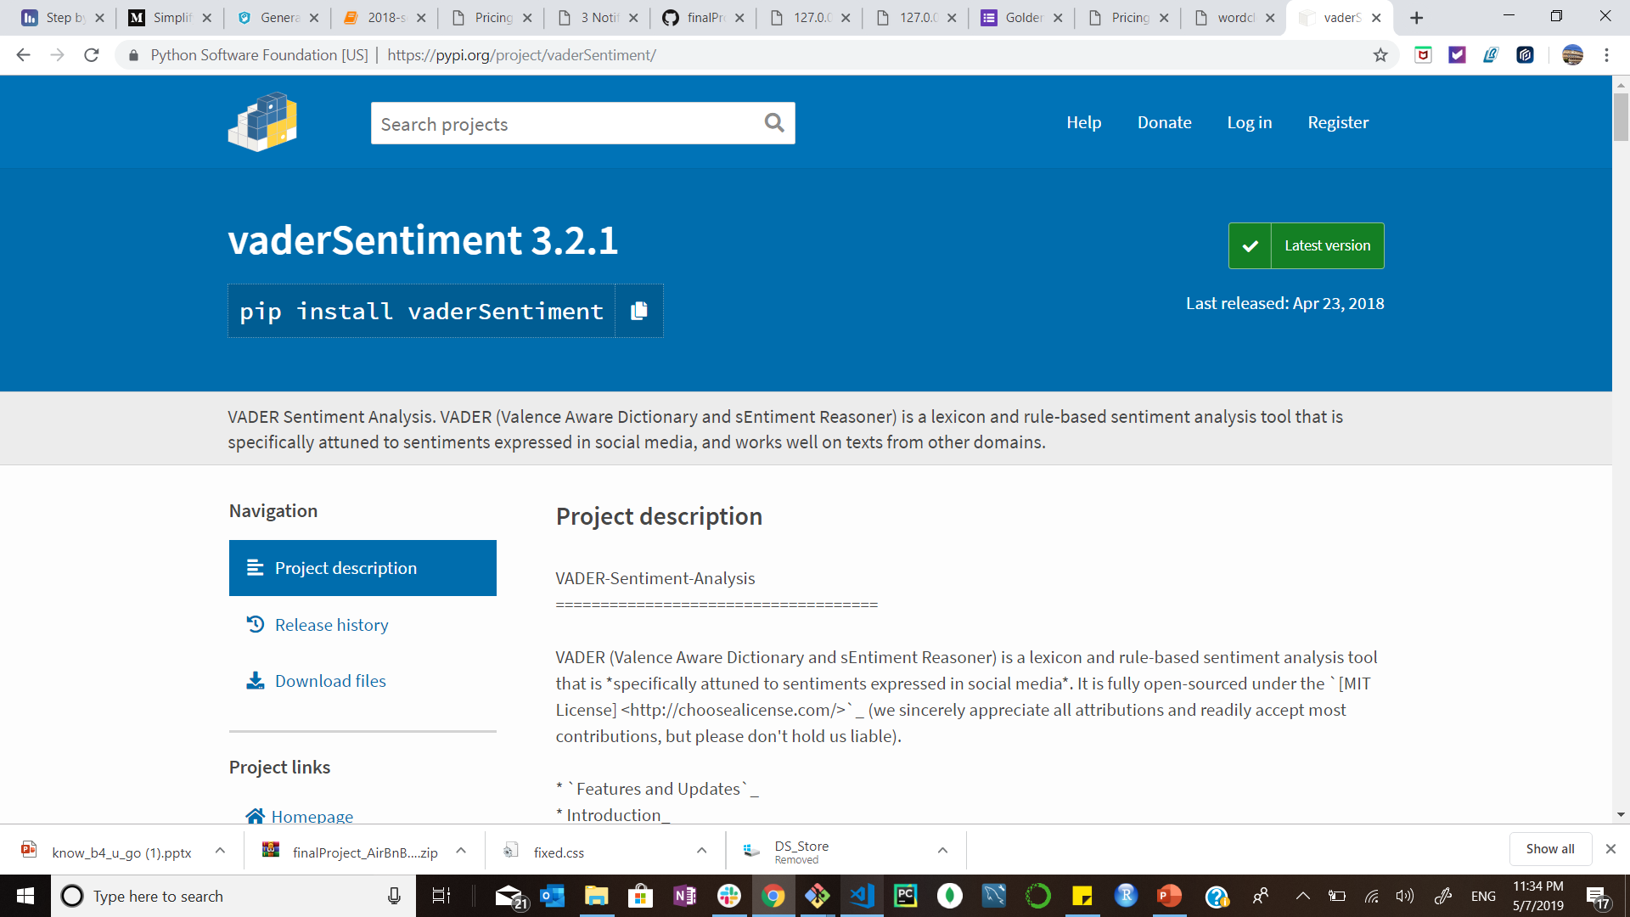
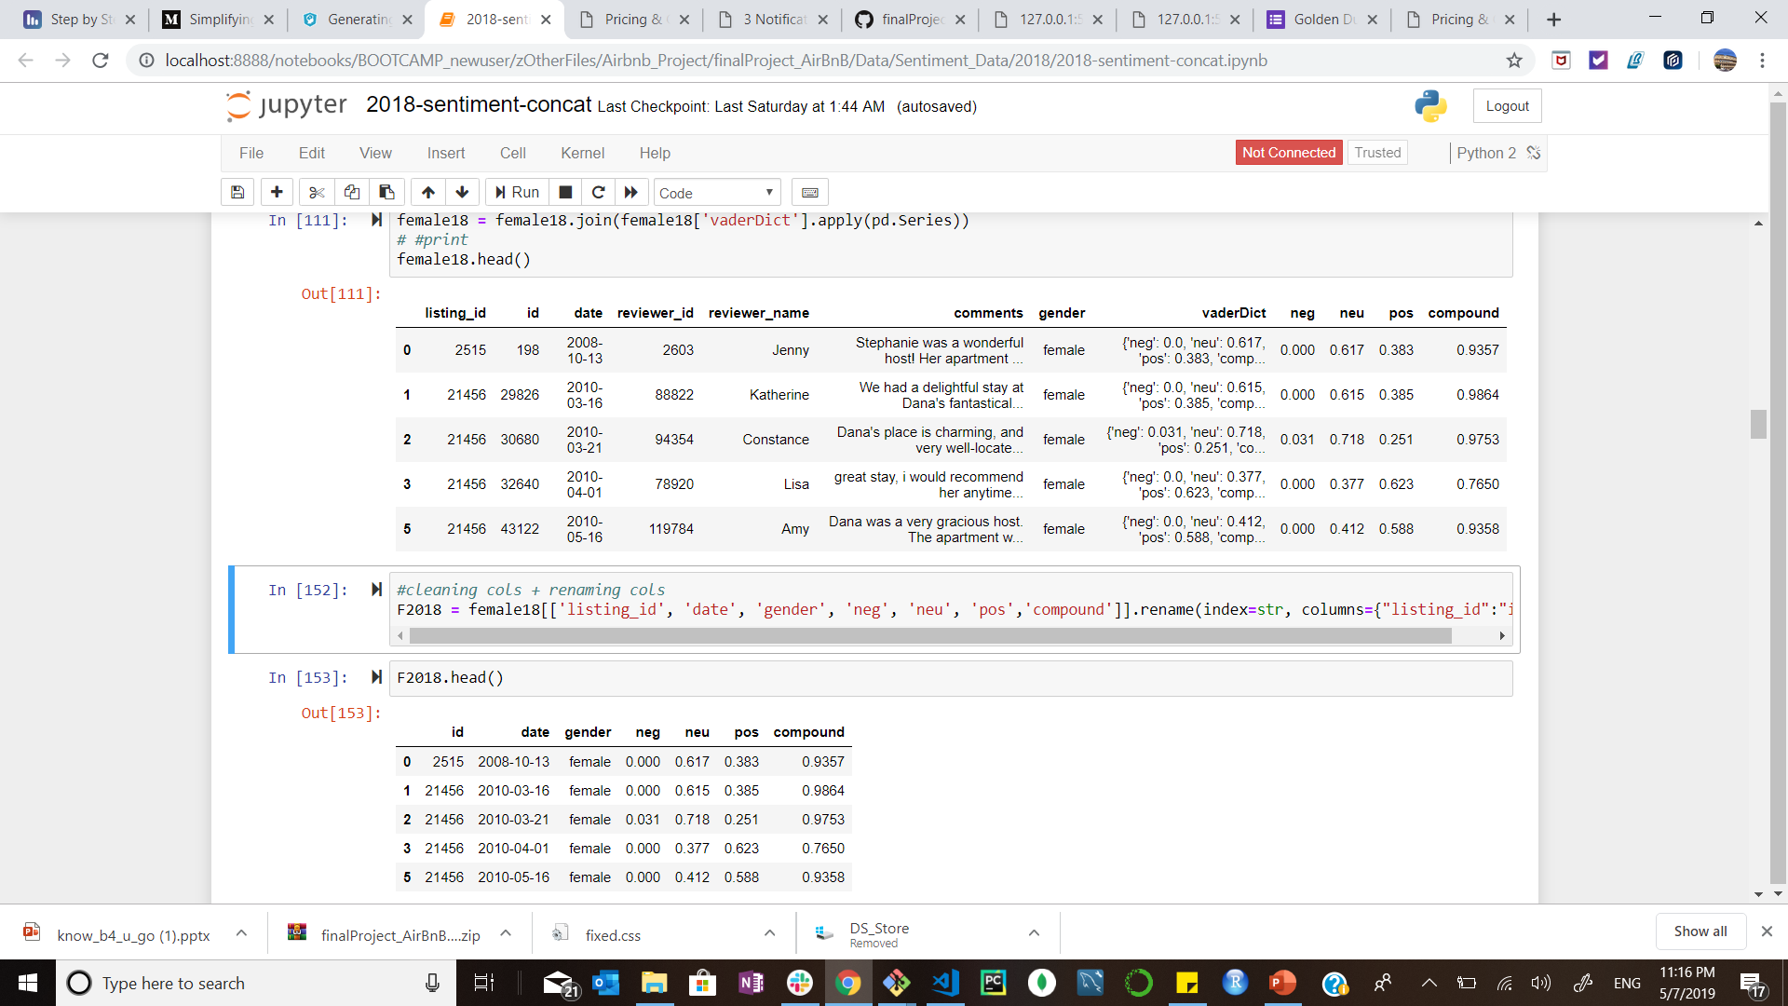
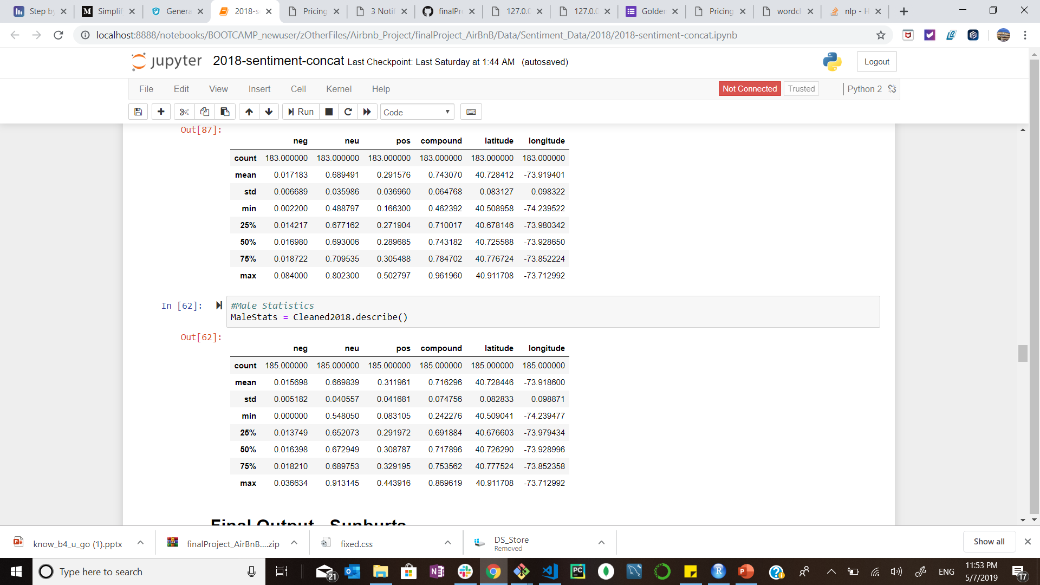
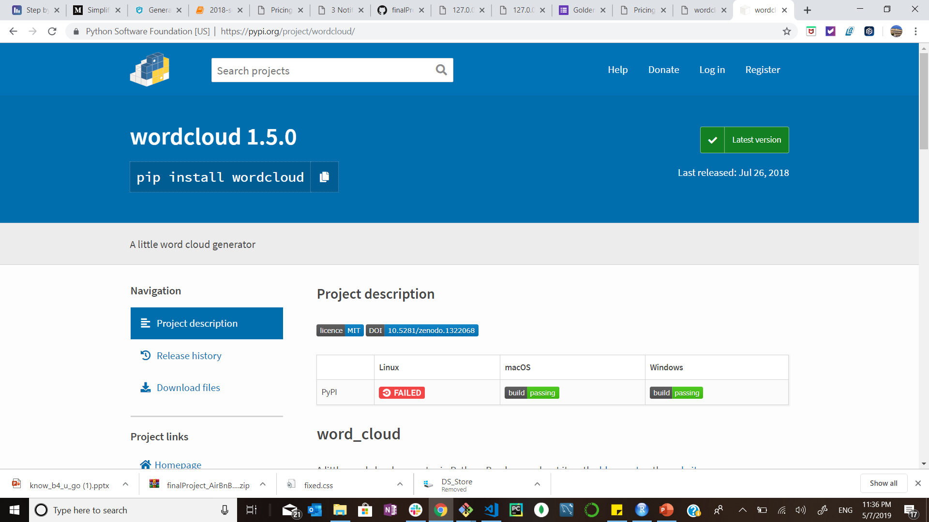
AIRBNB reviews & insights
Reviews
Notes:
Gender-detector:
Grabs “reviewr-name” column and identifies the gender and appens to new col
Groupby results
For simplicity kept “female” and “male” results
Vander-Sentiment:
It examines the lexicon and weights words into 4 categories
NEG, Neutral, POS, Compound(-1 to 1)
Ran a statistical report to retrieve the Average Scores per categories for each Gender
Word-Cloud:
Represents word frequency analysis resulting in words with higher counts relatively bigger than those with smaller number of appearances.

